Slide 1
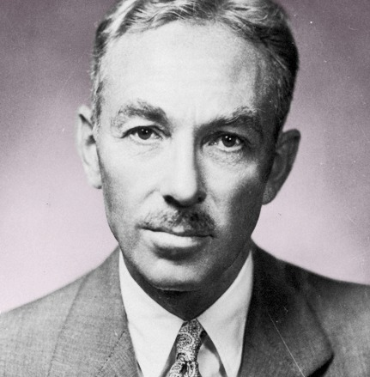
Once More to the Lake
By E.B.White

Slide 2
Introduction:
It is an essay first published in Harper’s Magazine in 1941 by author E.B.White.
White, explores the old-age relationships between a father and his growing son.
This transformative essay contains many themes and rich details lurking beneath the narrative.
White reflects in his own childhood.
This essay moves in a non-chronological order.

Slide 3
Main Idea:
In “Once more to the lake”, the lake serves as the setting for both author’s past and the present.
White reflects on his own childhood when his father would take him to the lake he then explains that now he his taking his own son to that very same lake.
White describes a dual existence that he experiences when spending time with his son at the lake.
This dual existence is apparent whenever White has hard time distinguishing himself from his own son.
White is lost to the setting, suffering and identity crises.

Slide 4
Themes:
Theme of Immortality.
Theme of Nostalgia.
Theme of Man Vs Himself.
Stream of Consciousness.
Past Vs Present.
Old Technology Vs New Technology.
Theme of Satire.

Slide 5
Setting of the Lake:
This setting of the lake is very important because White sees his son’s maturation is sign that he is getting closer to death.
There is a theme of immortality, because he wanted to spend his with his son. White refusal to death.
Internal Conflict: He is a father and a child too. There is a conflict of man vs himself and it refers to the main character in the interior mind. Neurotic Dilemmas.
He yearns to dig back into the past.
Death is approaching, he starts accepting the mortality.

Slide 6
Sensory Details:
The Sensory Details which are the details that engage the five senses, pervade this passage, allowing us to hear the sound of mandolins; we can here the girls singing; we can taste the sugar-dipped donuts; we can see the moonlight sails. White longs to relive these years when he first started to think about girls. In a sense, White maybe experiencing what would you called a mid-life crises, but by the end of this essay, the crises is resolved.
Lake is a holy spot for White. So many moments there acknowledge him that time has past there is theme of nostalgia is a romantic, rose-colored way of looking at the past.
Stream of consciousness: Wondering between past and present.

Slide 7
Conclusion:
Departure from reality into what he wants to see. Based on childhood experiences, White considers that somethings do not change.
Permanence of somethings.
Lake did not change.
New-boats become bothered.
Technology is destructive too.
He likes old engines because of the noise.
Nothing is constant in this world.
Thought of a person cannot change, perception switch.
Lake shows development.

